Slide 1

Adapted from Dr. Craig Chase, The University of Texas at Austin

Slide 2

C (and C++) have just about the most powerful, flexible and dangerous pointers in the world.
  Most other languages (e.g., Java, Pascal) do not arm the programmer with as many pointer operations (e.g., pointer arithmetic)
Your best defense is to understand what pointers really mean and how they really work.

Slide 3
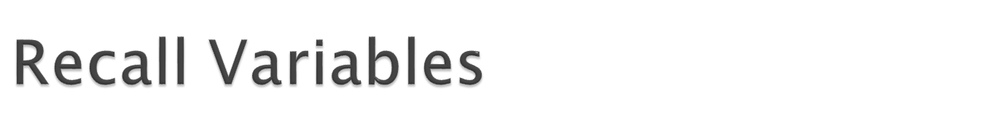
Recall a variable is nothing more than a convenient name for a memory location.
  The variable’s scope defines when/if the memory location can be re-used (e.g., two different local variables in different subroutines may use the same memory location at different times).
  The type of the variable (e.g., int) defines how the bits inside that memory location will be interpreted, and also define what operations are permitted on this variable.
Every variable has an address.
Every variable has a value.

Slide 4
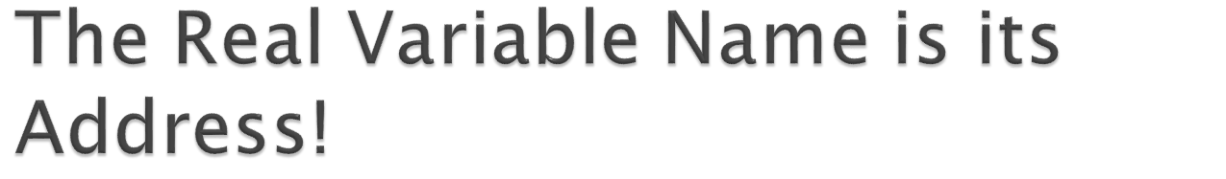
When your program uses a variable the compiler inserts machine code that calculates the address of the variable.
  Only by knowing the address can the variables be accessed (hence the FP and activation record stuff).
There are 4 billion (2³²) different addresses, and hence 4 billion different memory locations.
  Each memory location is a variable (whether your program uses it or not).
  Your program will probably only create names for a small subset of these “potential variables”.
  Some variables are guarded by the operating system and cannot be accessed.

Slide 5
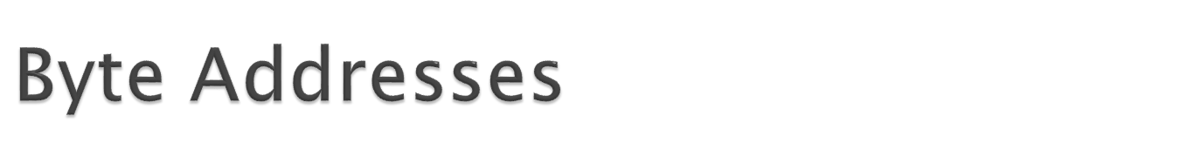
Most computers are “byte addressable”
  That means that each byte of memory has a distinct address
Most variable types require more than one byte
The “address” of a variable is the address of the first byte for that variable

Slide 6
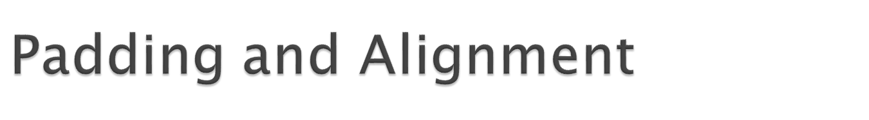
The compiler and linker are not obligated to store variables in adjacent locations (except for arrays)
The compiler might request “padding” between small variables
  The hardware may be faster at loading large pieces of data from some addresses than others
Choosing an address where the least significant k bits are zero is called “alignment to a 2^{k}-byte boundary”

Slide 7
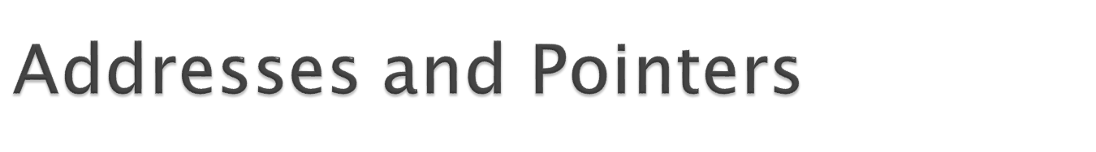
A pointer variable is a variable!
  It is stored in memory somewhere and has an address.
  It is a string of bits (just like any other variable).
  Pointers are 32 bits long on most systems.
  The value of a pointer must be set by assigning to the pointer (and can be changed by assigning a different value – just like any other type of variable).
The bits inside a pointer are interpreted as the address of another variable.
  This other variable can be accessed using the pointer, instead of using the variable’s name.

Slide 8
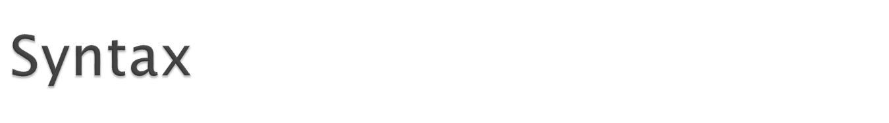
Declaring a pointer:
  int* p;
  Declares a variable p of type “pointer that holds the address of an int variable”.
Calculating the address of a variable and storing it in a pointer:
  p = &x;
  x is an int variable. “&x” is an expression that evaluates to the address of x.
  The assignment to p is just normal assignment (after all, p is just a variable, right?).

Slide 9
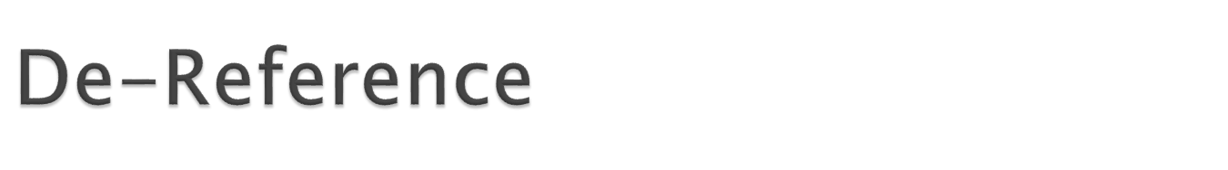
If p holds the address of another variable x we can now access that variable in one of two ways:
  using the name of the variable: x = 42;
  “dereferencing” the pointer: *p = 42;
NOTE: both of these assignments mean exactly the same thing (provided, of course, that the current value of p is the address of x).
A dereferenced pointer can substitute for the variable – anywhere. *p and x mean exactly the same thing.

Slide 10
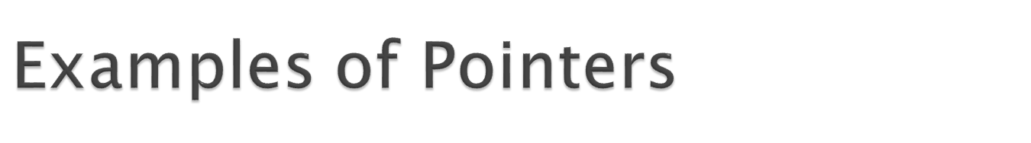
The same pointer can “point to” multiple variables (not at the same time, of course):
  p = &x; // p points to x
  x = x + *p; doubles x
  p = &y; // now p points to y
  *p = 42; // y is set to 42 (x is unchanged).
An infinite loop (obviously):
p = &x;
x = 0;
while (*p == x) {
print x;
*p = *p + 1;
}

Slide 11
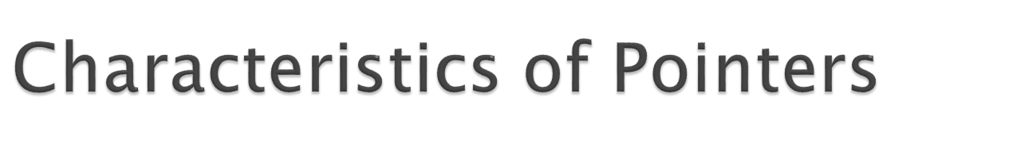
We’ve seen that pointers can be initialized and assigned (like any variable can).
  They can be local or global variables (or parameters)
  You can have an array of pointers
  etc., just like any other kind of variable.
We’ve also seen the dereference operator (*).
  This is the operation that really makes pointers special (pointers are the only type of variable that can be dereferenced).

Slide 12
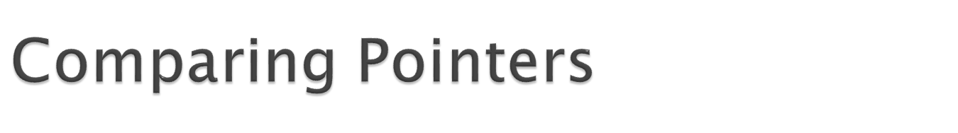
Pointers can also be compared using ==, !=, <, >, <=, and >=
  Two pointers are “equal” if they point to the same variable (i.e., the pointers have the same value!)
  A pointer p is “less than” some other pointer q if the address currently stored in p is smaller than the address currently stored in q.
  It is rarely useful to compare pointers with < unless both p and q “point” to variables in the same array (more on this later).

Slide 13
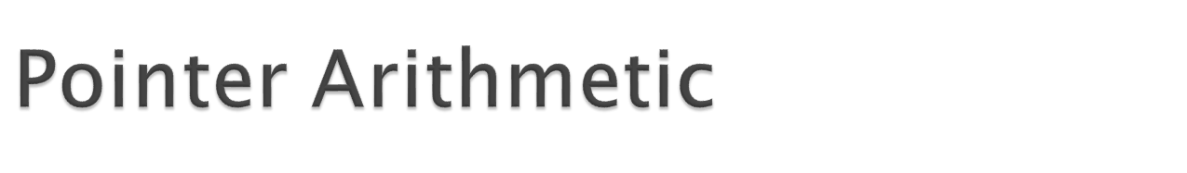
Pointers can be used in expressions with addition and subtraction. These expressions only make sense if the pointer points at one of the variables in an array!
Adding an integer value k to a pointer p calculates the address of the k^{th} variable after the one pointed to by p.
  if p == &x[0]then p + 4 == &x[4];
  Negative integers can also be added (same as subtracting a positive).
Subtracting two pointers calculates the (integer) number of variables between the pointers.

Slide 14
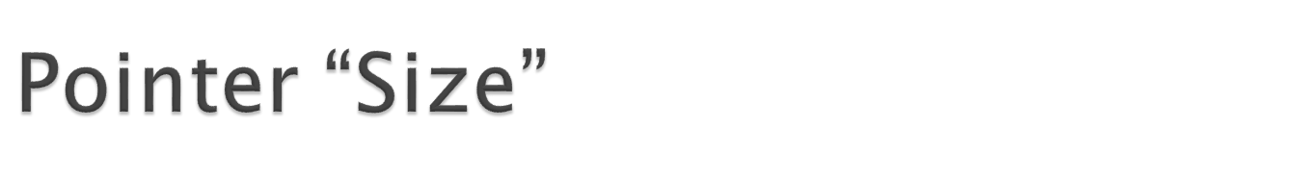
Note: Pointers are all the same size. On most computers, a pointer variable is four bytes (32 bits).
  However, the variable that a pointer points to can be arbitrary sizes.
  A char* pointer points at variables that are one byte long. A double* pointer points at variables that are eight bytes long.
When pointer arithmetic is performed, the actual address stored in the pointer is computed based on the size of the variables being pointed at.

Slide 15
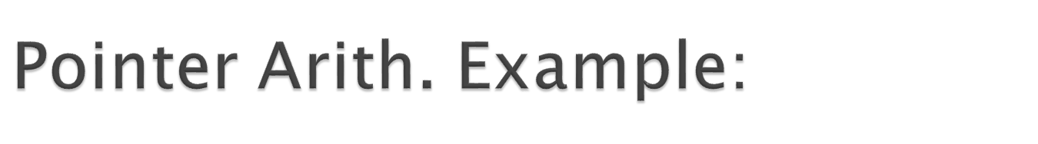
int numbers[10];
int* p = &numbers[0];
int first_address = p;
int last_address;
while (p != &numbers[10]) {
*p = 42;
p = p + 1;
}
last_address = p;
NOTE: last_address == first_address + 40

Slide 16
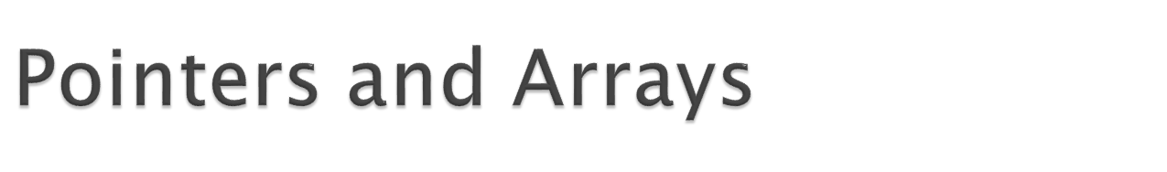
Pointers and arrays are absolutely not the same things!
  A pointer is one variable.
  An array is a collection of several variables
Unfortunately, C syntax allows pointers to be used in similar ways as arrays.
  Specifically, for any integer i and pointer p the following two expressions reference the same variable:
    *(p + i)
    p[i]

Slide 17
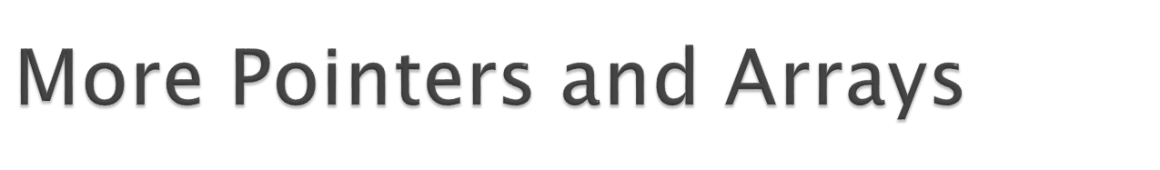
To ensure that we achieve maximal confusion, the name of an array can be used to substitute for the address of the first variable.
  int stuff[10]; // stuff == &stuff[0]
This innocent looking rule means that arrays can not be passed as arguments to functions!!!!
  Instead of passing the array, one passes the address of the first variable.
    doit(stuff); // “stuff” is the address of the first variable
  The pointer parameter can be declared as a normal pointer, or using the (extremely misleading) syntax:
    int doit(int x[10]) { // x is really a pointer
    int doit(int* x) { // same thing!
    int doit(int x[]) { // you can do this too x is a ptr.

Slide 18
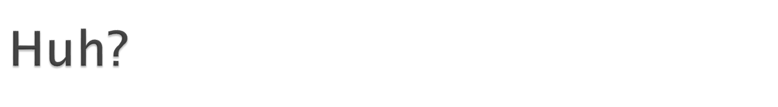
Is there really something tricky going on with arrays as parameters?
  Sure, try this:
void doit(int a, int x[10]) {
a = x[0] = 42;
}
void main(void){
int nums[10] = { 0 };
int k = 17;
doit(k, nums);
}
  Note that k is not changed, but nums[0] is set to 42!

Slide 19
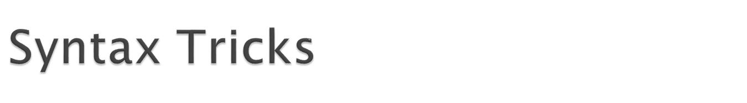
The C-language support for arrays is really quite limited.
  In effect, C doesn’t support arrays at all, just pointers and pointer arithmetic.
  (that’s why we’re avoiding 2D arrays).
Think about it, if x is the name of an array. Then:
int x[10];
int* p = x;
x[3] = 2;
p[3] = 42; // same, in fact same as *(p + 3) = 42
So, the C support for arrays is limited to declaring them. Everything else is really pointers!

Slide 20
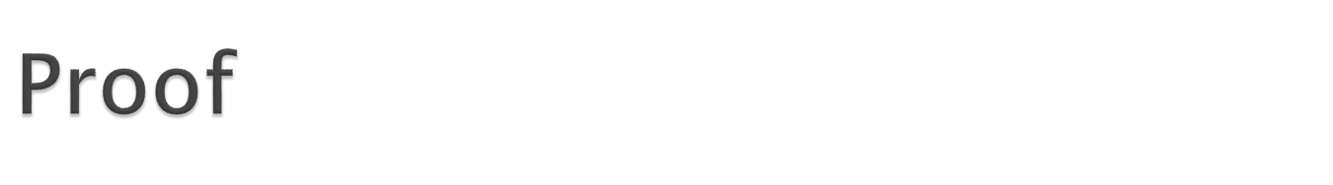
void doit(int x[10], int* p) { // two pointers
int y[10]; // a real array of ten variables
x += 1; // legal, x is really a pointer variable
*x = 42; // legal
p += 2; // legal
*p = 3; // legal
y += 1; // illegal, y is not a variable! y[i] is a variable!
*y = 5; // legal, ‘cause *y is same as *(&y[0])
}
Keep in mind that the name of a (real) array is “an expression evaluating to the address of the first variable”. A little like saying “3 is an expression evaluating to the number 3. You can’t say in C: “3 = 10;” So, you can’t say “y = &y[1];”

Slide 21
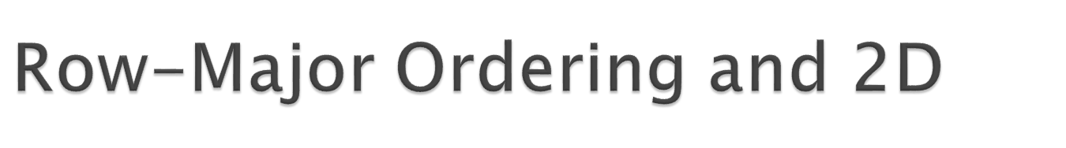
C stores arrays declared as two-dimensional using a one-dimensional array (of course).
  The first elements stored are those in the first row (in order). Then, the second row is stored, etc.
  This memory allocation policy is called “row-major ordering”.
If we want to access a variable in row i and column j, then that variable is located at the following offset from the start of the array.
  i * num_columns + j;

Slide 22
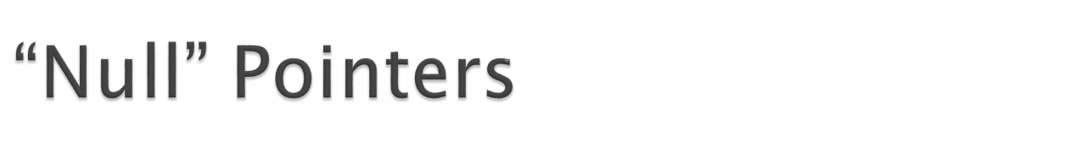
C gives the OS and compiler a lot of freedom with addresses:
  e.g., Variables can have funky alignment, for example many char variables “use up” 4 bytes
However, one address is special: address zero.
  No variable or function can be stored at address zero.
  It is never legal to store a value into the memory location at address zero (doing so results in a runtime error, AKA “Core Dump”).
The reason that zero is reserved is so that programmers can use this address to indicate a “pointer to nothing”.

Slide 23

Imagine writing a function findIt that returns a pointer to the first occurrence of the letter ‘z’ in a string.
  What should you return if there are no ‘z’s in the string? How about the address zero?
char* findIt(char* str) {
while (*str != ‘\0’) {
if (*str == ‘z’) { return str; }
str += 1;
}
return 0;
}

Slide 24
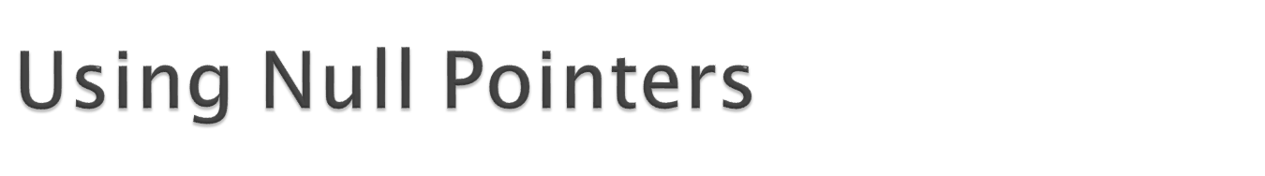
By convention, a pointer who’s value is the address zero is called a “null pointer”.
The literal “0” can be assigned to a pointer without making the compiler grumpy.
  Note that an integer variable or any other constant cannot be assigned without a “type cast”.
Many people get confused between a pointer who’s value is the address zero, and a pointer that points to a variable with the value zero.

Slide 25
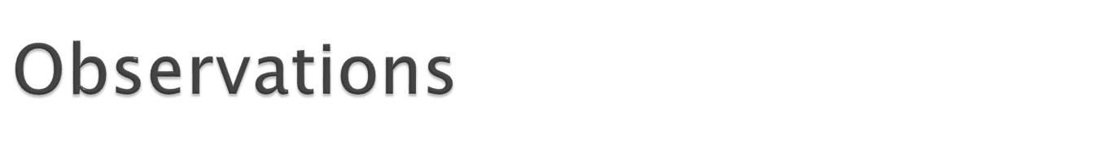
The first key is to understand what it means to “dereference” something.
The next key is to understand why some expressions can’t be dereferenced.
The last key is to understand the auto-scaling that’s performed during pointer arithmetic.

Slide 26
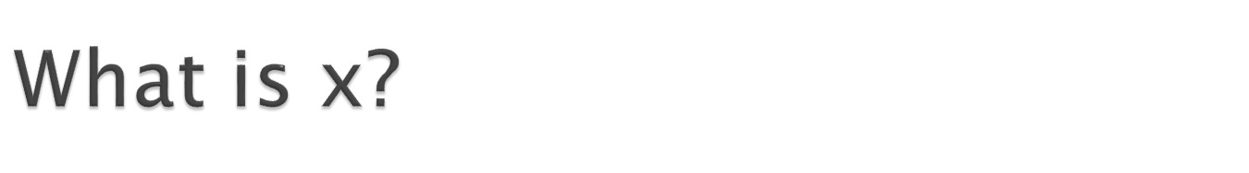
Can only be answered in context
  x is really a location.
  Usually when we ask this question, we mean “what is the value of x”
  Sometimes, we really mean the location
x = 42;
In this context, x is a memory location.

Slide 27
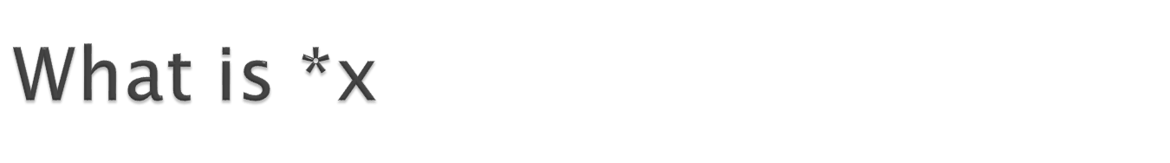
*x is a memory location
To know which memory location, we need to know the value of x
  For example, if x is 3, then *x is location 3
If *x is on the left hand side of an assignment, then we will store a value into location x
If *x appears on the right hand side of an assignment, then we are talking about the value of location x

Slide 28
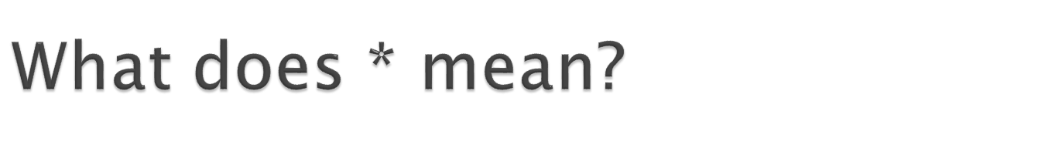
*(anything) means
  Figure out the value of “anything” and
  Use that memory location for whatever it is that we’re trying to do
*3 = 6; // put the value 6 into location 3
*5 = *3; // put 6 (the value in location 3) into location 5
If there are two (or more) *s, then just apply them from right-to-left
**3 = 42; // find out the value of location 3, (6 in our example), then put 42 into location 6

